Slide 1

Generative Pretrained Transformers
Peter Pichler
11821941
Digital Organizations

Slide 2
What this presentation aims to do
1) explains the model architecture, 2) highlights the main components of the model architecture (e.g. attention, encoder, decoder, etc.) in more detail, 3) connects the presented architecture to the code 4) and explains the main mathematical functions that perform specific tasks in the model.

Slide 3
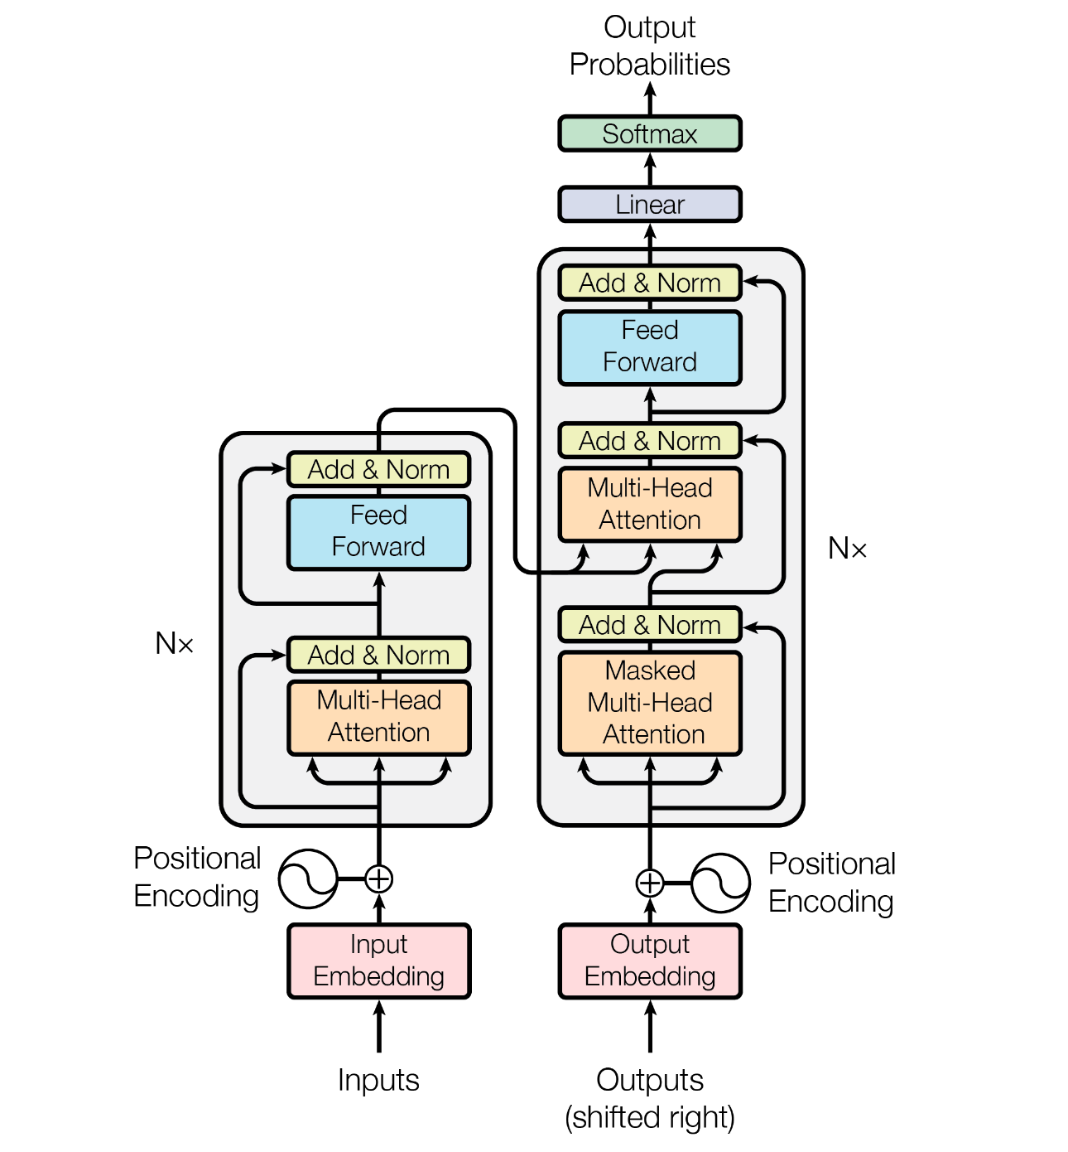
General overview
Encoder-decoder structure.
Encoder maps input symbols to continuous representations.
Decoder generates output symbols sequentially.
Auto-regressive model using previously generated symbols.
Transformer architecture for encoder and decoder.
Stacked self-attention and fully connected layers used.

Slide 4
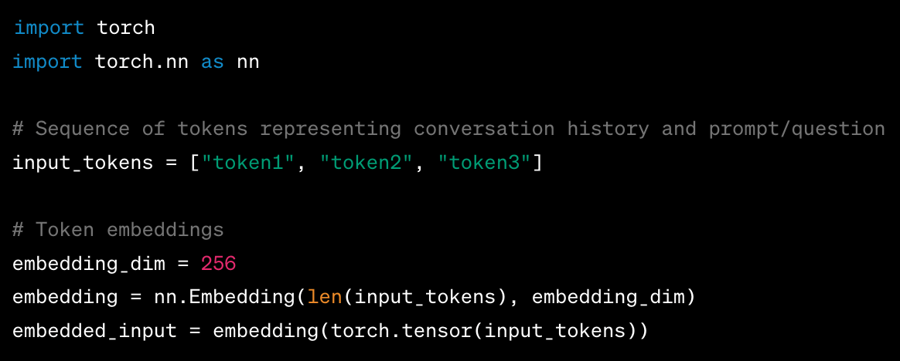
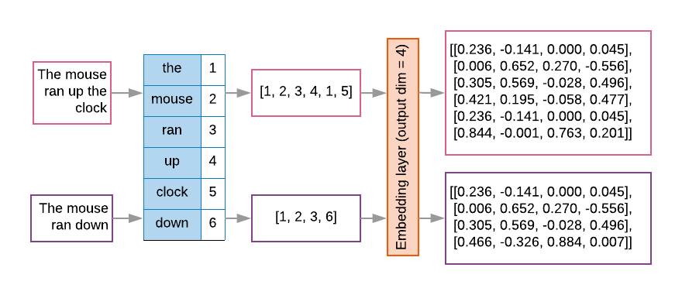
Input Encoding
Input Encoding: Sequence of tokens representing conversation history and current prompt/question.
Tokens are embedded into continuous vector representations (token embeddings).

Slide 5
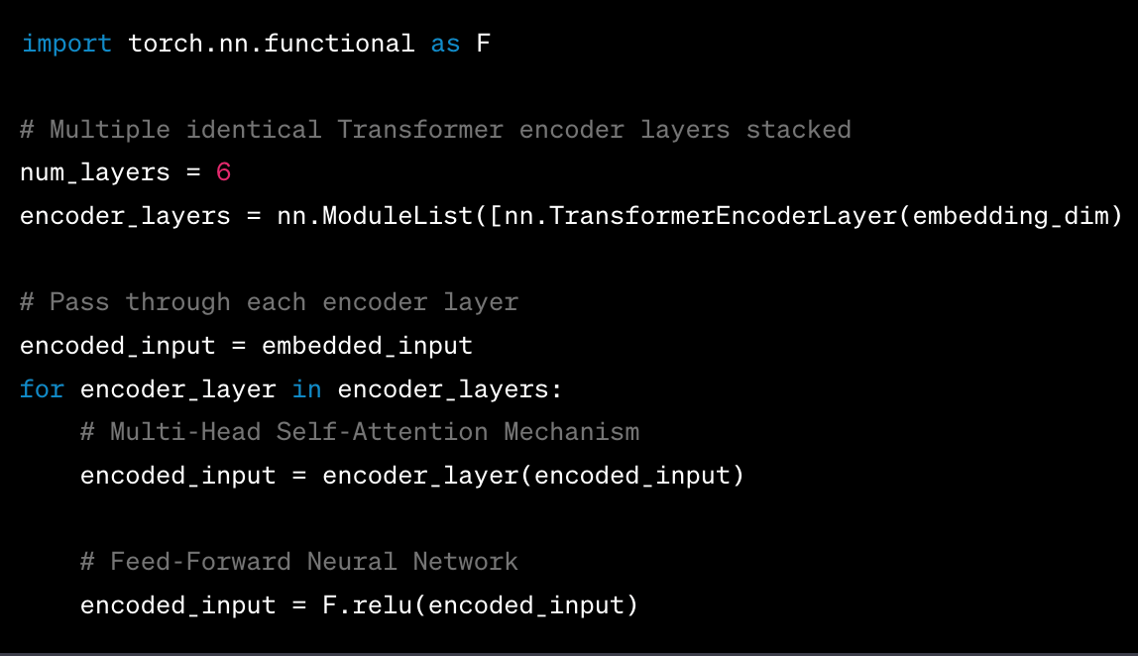
Transformer Encoder Layers
Stacked Transformer encoder layers with 2 respective sublayers:
Multi-Head Self-Attention Mechanism: Attends to different positions, captures contextual information.
Feed-Forward Neural Network: Applies position-wise fully connected feed-forward network.

Slide 6
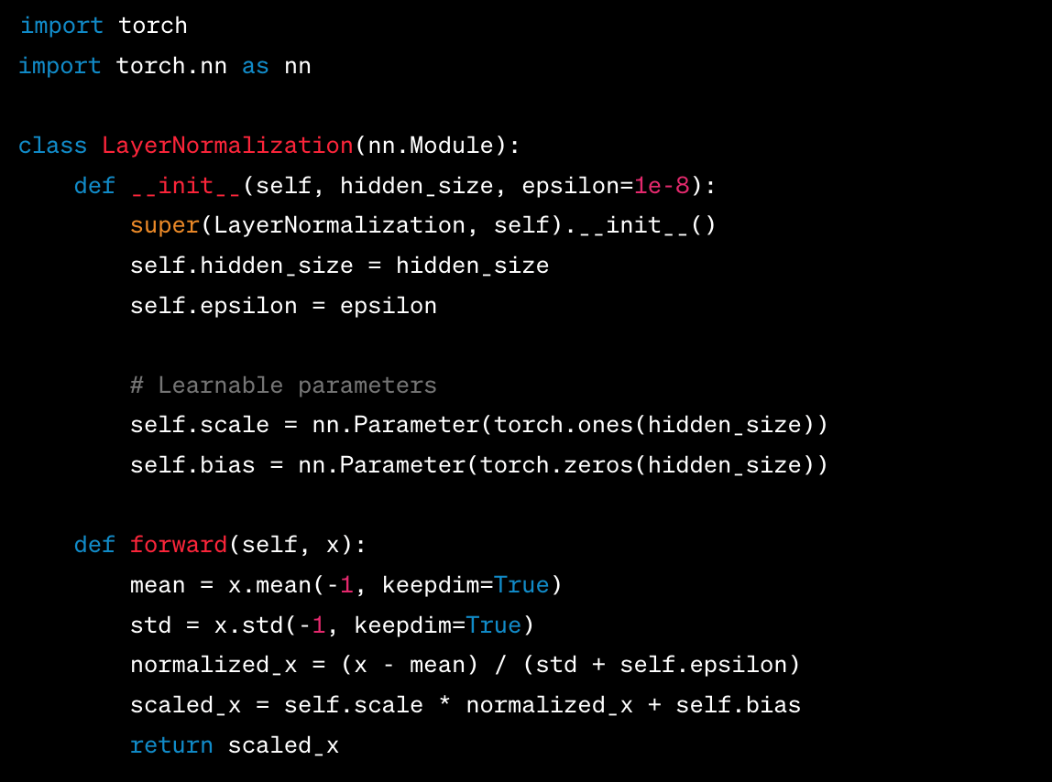
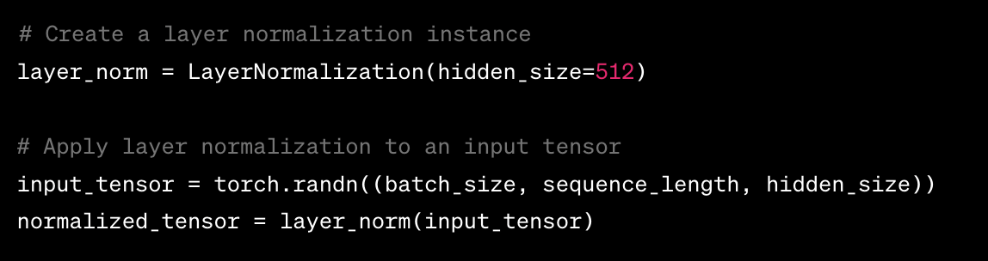
Layer Normalization
Applied after each sub-layer within an encoder layer.
Normalizes outputs and facilitates stable training.
Prevents unstable gradients during training (e.g., exploding or vanishing gradients).
Positioning of layer normalization affects gradient behavior.
Pre-Layer Normalization (Pre-LN) variant improves gradient stability.

Slide 7
Layer Normalization
1. Calculate the mean (μ) and standard deviation (σ) of the input tensor:
μ = (x1 + x2 + ... + xn) / n σ = sqrt(((x1 - μ)^2 + (x2 - μ)^2 + ... + (xn - μ)^2) / n)
2. Normalize the input tensor by subtracting the mean and dividing by the standard deviation:
y = (x - μ) / σ
3. Scale and shift the normalized tensor using learnable parameters:
y' = γ * y + β

Slide 8
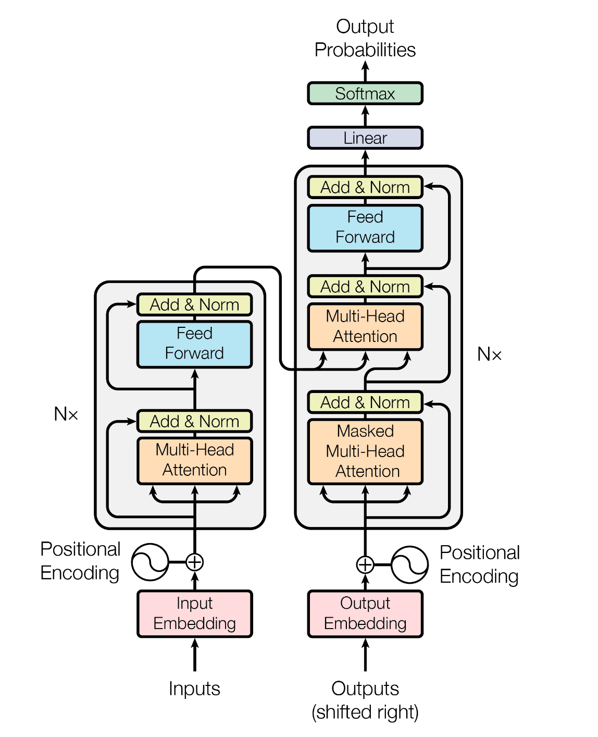
Decoder Layer
Composed of a stack of N = 6 identical layers
Each decoder layer includes three sub-layers:
Multi-head attention over the encoder stack output
Self-attention (modified to prevent attending to subsequent positions)
Feed-forward neural network
Residual connections and layer normalization are employed around each sub-layer
Masking is applied to prevent positions from attending to subsequent positions
Output embeddings are offset by one position to maintain causality in predictions

Slide 9
Why Attention?
It helps the model understand context and meaning.
Captures long-range dependencies between tokens.
Provides flexibility and adaptability.
Improves coherence in generated responses.
Computed within each decoder/encoder layer
→ Multi-head attention (explained specifically later)

Slide 10
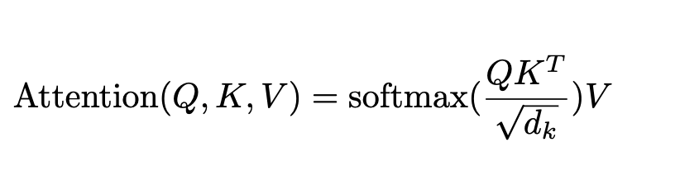
Attention explained
Scaled Dot-Product Attention: Type of attention mechanism used.
Dimensions: Queries and keys have dimension dk, values have dimension dv.
Dot Product: Calculates dot products of queries and keys.
Scaling: Scales dot products by square root of dk.
Softmax: Applies softmax to obtain weights.
Weighted Sum: Multiplies values by weights and sums for output.
Compute attention function on packed queries Q, keys K, and values V.

Slide 11
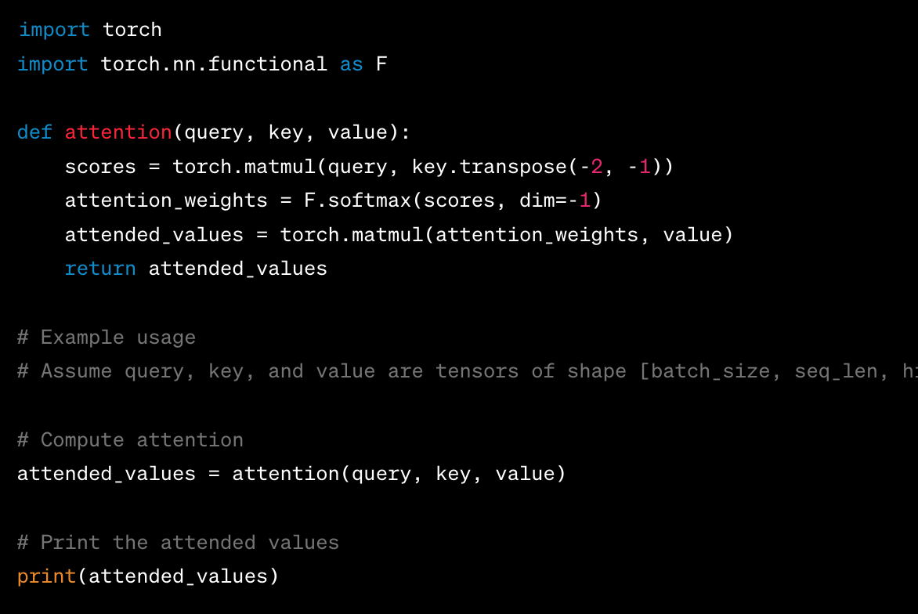
Basic example of Attention in Python

Slide 12
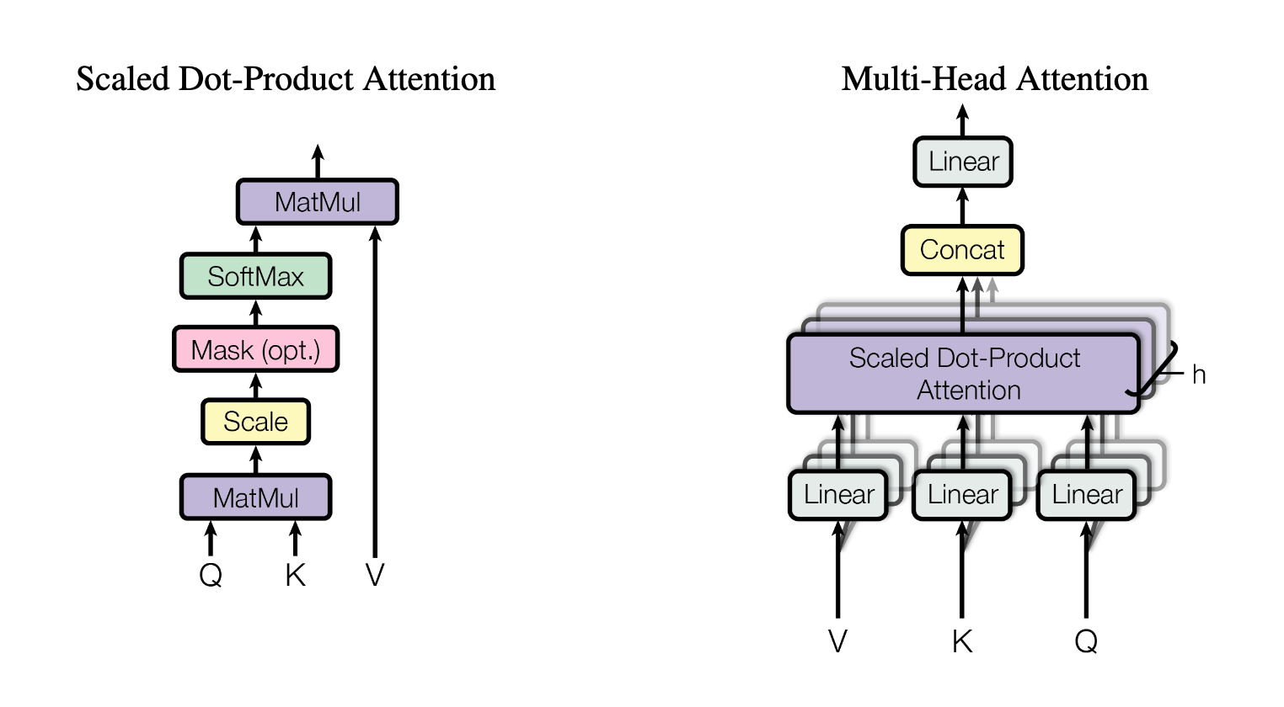
Attention vs. Multi-Head Attention

Slide 13
Multi Head Attention
Multi-Head Attention: Multiple attention functions used.
Linear Projection: Queries, keys, and values projected h times to different dimensions.
Parallel Attention: Attention function performed in parallel on projected queries, keys, and values.
Joint Attention: Allows attending to different subspaces at different positions.
Enhanced Information: Single attention head averaging inhibits joint attention capability.

Slide 14
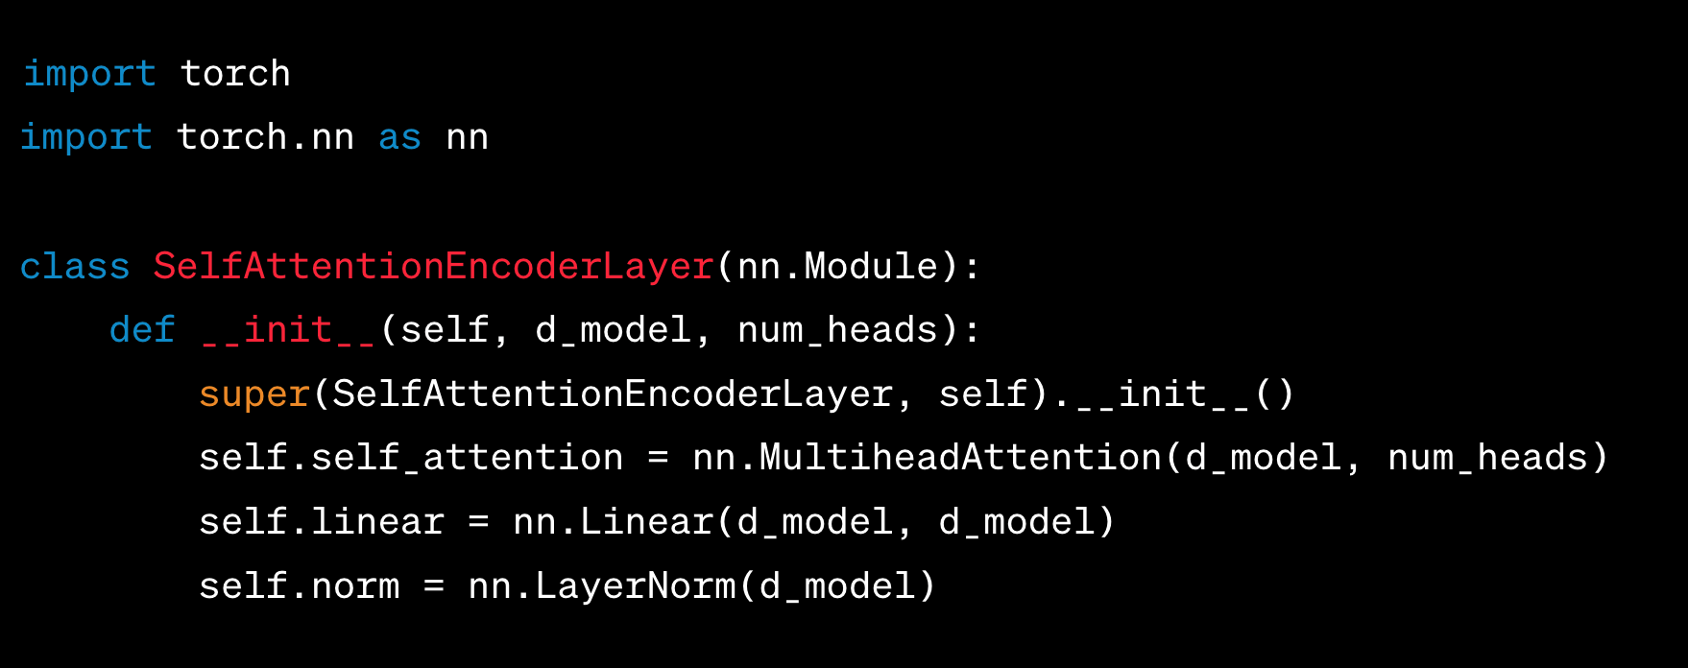
Attention in encoders/decoder layers
Used in 3 ways in the architectur.
Encoder-decoder attention: Decoder attends to all positions in the input sequence.
Encoder self-attention: Encoder attends to all positions in the previous encoder layer.
Decoder self-attention: Decoder attends to all positions in the decoder, including the current position.

Slide 15
Position-wise Feed-Forward Networks
Each layer has a connected feed-forward network.
Operates on each position individually.
Structure: Two linear transformations with ReLU activation.
Formula: FFN(x) = max(0, xW1 + b1)W2 + b2 (2)
Linear transformations vary across layers.

Slide 16
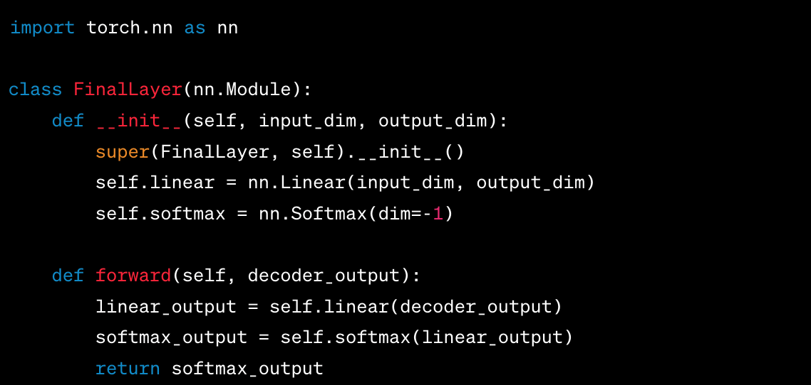
Output Projection
Final layer of the model.
Linear transformation followed by softmax activation.
Maps decoder outputs to a probability distribution over the vocabulary.
Enables generating the next token in the response sequence.

Slide 17
Why is GPT performing so well?
Feedforward neural network enhances attention with non-linear transformations and position-wise processing.
Attention captures global dependencies and long-range relationships.
Feedforward network captures local patterns and fine-grained details.
Combination enables the model to capture both local and global contextual information.
→ Improved performance in language understanding and generation.

